Slide 1
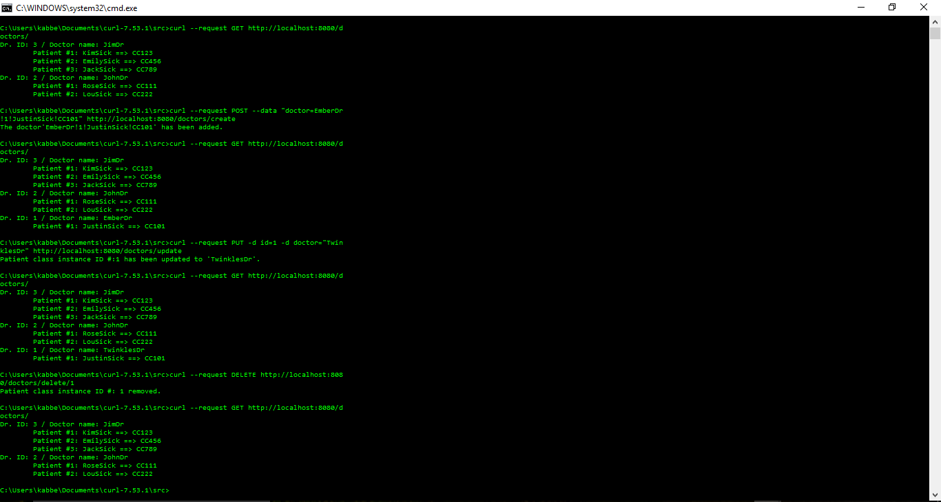
Curl operations

Slide 2
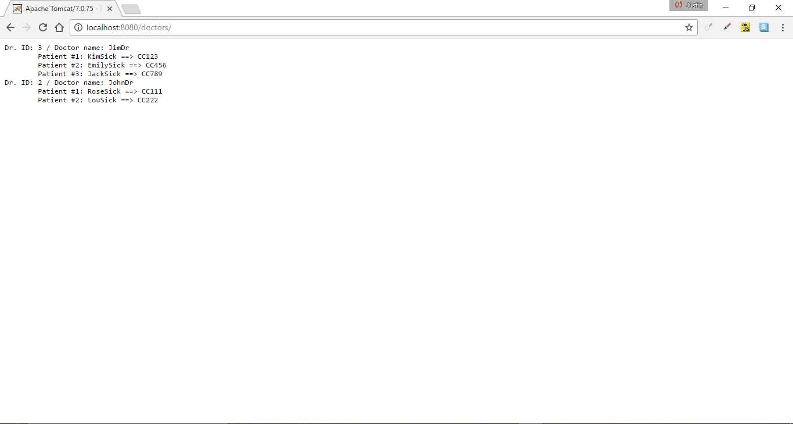
Web browser

Slide 3

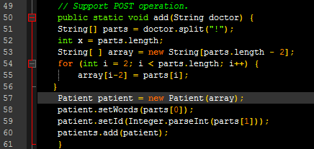
Patients.java snippets
Array
Support POST operation

Slide 4
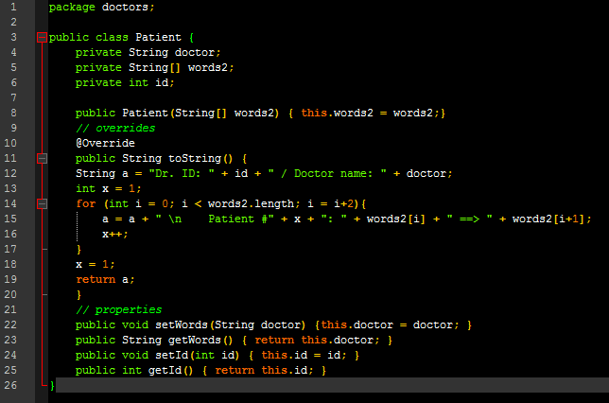
Patient.java

